Slide 1
Memorial Elementary Dual Language

Slide 2
District Vision
Recognizing that, in order to successfully compete in a diverse market economy, students must have access to a bilingual and bicultural education, HISD will phase-in a consistent world-class Dual Language bilingual program that graduates students who are fully biliterate in English and Spanish.

Slide 3
Two-Way Dual Language Program
Additive program
A combination of native Spanish speakers and native English speakers are taught together in an effort to develop full bilingualism and bi-literacy for both groups of students.
Notes:
The goal of the program is to add another language
The goal is to have 50% native English speakers and 50% native Spanish speakers in a class
Bi-literacy includes ALL content areas

Slide 4
Primary Goals
The development of fluency and literacy in English and Spanish for all students
The promotion of bilingualism, biliteracy, cross-cultural awareness, and high academic achievement

Slide 5
Primary Goals
The integration of English speakers and English language learners for academic instruction, in accordance with the selected program design and model. Whenever possible, 50% of the students in a program should be dominant English speakers and 50% of the students should be native speakers of Spanish.

Slide 6
Houston ISD Dual Language History
1994
2012
2013-2014
Dual Language programming started in HISD; Some programs started and stopped before 2012.
The expansion of DL programming picked up again.
Spring 2012= 12 DL participating campuses (9 ES/2MS/1HS)
August 2012= 5 additional ES started DL
The goal is to gradually phase out Transitional BE at the elementary level and replace it with DL as the only BE program for qualifying ELLs. Expansion to MS and HS will be strategic based on geography.
August 2014
Planning for more aggressive expansion-visited several districts in Texas and others across the US and established aligned programming, support systems and implementation for 14 existing ES.
Additional expansion is a district priority
August 2015
14 additional elementary campuses started DL implementation
The DL programming expanded to 25 additional campuses (22 elementary, 2 ECC, 1 MS) for a total of 56.

Slide 7
Program Standards and Non-Negotiables
A minimum of 50% to a maximum of 80% of daily instruction in the non-English language
Equitable access to students, screening only for language dominance and for ELL program qualification
Strategic separation of languages on the part of the instructor—no translation
Notes:
First bullet: this will depend on whether the model is 50/50 or 80/20
Second bullet: Entrance process is explained in slide 9
Third bullet: Lessons are not translated, instead instruction is delivered in a comprehensible way (by using second language acquisition strategies) to ensure student understanding in all content areas

Slide 8
Program Standards and Non-Negotiables
Kindergarten-fifth grade (Kindergarten through twelfth grade is encouraged)
Programmatic, curricular, and instructional decisions based on research in the field
Rigorous core academic curriculum that is aligned to the Texas Essential Knowledge and Skills (TEKS)
Notes:
First bullet: Research shows that it takes at least 5-7 years to reach academic proficiency (Thomas & Collier)

Slide 9
As parents
Participate in the activities organized by the school
Participate in reading activities. Read everyday with your child-in both languages
Talk WITH your child to maximize language experiences
Answer your child’s questions about language in order to support their language development at home

Slide 10
As parents
Volunteer hours: 5 hours per semester/10 hours total per year
Classroom parent, PTA/PTO, festivals, field trips, reading club, school garden, boosterclub, ESL/computer/health classes, assist teacher from home, read to or tutor students, family nights
Dual Language bilingual program yearly meeting attendance requirements
Minimum of 1 parent group meeting (Parent Advisory Committee (PAC), PTO/PTA, Advisory)
2 parent conferences
4 Dual Language meetings

Slide 11
Dual Language Two-Way process for program participation
Completed Parent Commitment Form
Administration of IPT to determine language dominance and qualification for ELL programing
Class composition: 50% English dominant speakers & 50% Spanish dominant speakers
Notes:
First bullet: should be included in the packet that parents/community members receive
Second bullet: May be administered in English and Spanish

Slide 12
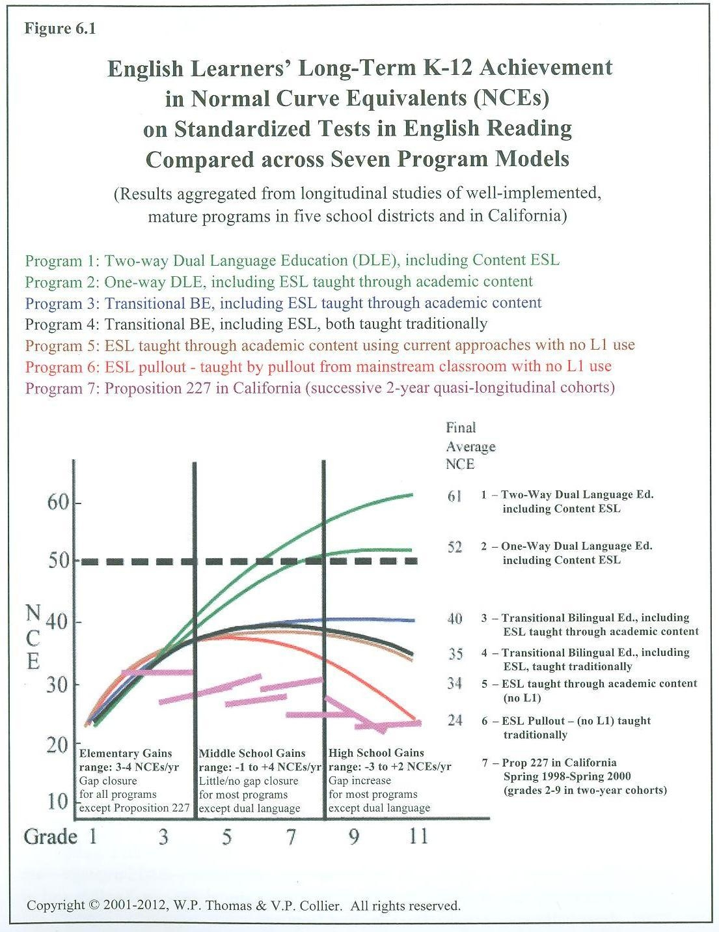
Notes:
This demonstrates a comparison of seven different bilingual program models. This graph is in:
Thomas, W., & Collier, V. (2012). Dual language education for a transformed world . Albuquerque,NM: Fuente Press. P. 93

Slide 13
80/20 DL Model
Language of Instruction Across the Grades
20%
30%
80%
40%
70%
50%
50%
50%
60%
50%
50%
50%
English Spanish
NOTE: 50/50 model is 50% Eng./50% Span starting from Grades K-5
Notes:
Please refer to DL Handbook and models under Principal Resources located at:
http://www.houstonisd.org/Page/106558

Slide 14
Achievement Patterns
Joint study by HISD and Rice University's Kinder Institute for Urban Research
One of the first independent studies of HISD’s Two-Way Dual Language program
The first study of the program that tracks students’ results over time
Cohort of ELLs who started kindergarten in 2007
Performance on Spanish-language reading tests and English tests

Slide 15
Achievement Patterns: Findings
Through 3rd grade, ELLs in two-way programs demonstrated higher Spanish reading scores and slightly faster growth than their peers in other bilingual programs.
Regardless of the type of bilingual program, ELLs who participated in their original program for approximately four years (through grade 3) had the highest English reading achievement.

Slide 16
Achievement Patterns: Findings
Of the BE programs offered, ELLs in the two-way dual language program had the best Spanish as well as English skills.
ELLs in two-way programs had consistently higher English performance.
With additional program exposure (greater than one year), two-way students met and surpassed the performance of students whose parents opted out of bilingual or dual-language programs.

Slide 17
Achievement Patterns: Findings
“From the district’s perspective, I’d want to keep expanding these programs, despite the expense, because you’re getting results.”
--Ruth N. López Turley, Director of Houston Education Research Consortium (HERC) and Associate Director of the Kinder Institute for Urban Research

Slide 18

Benefits of Bilingualism
Dual Language Expansion
Dual Language Program 2015

Slide 19
HISD Multilingual Education: Contact us
Website: http://www.houstonisd.org//Domain/8037
Blog: https://hisdmultilingual.wordpress.com/
Facebook: Houston ISD Multilingual
Twitter: @HISDMultiPrgms
Instagram: HISDMultilingual
Pinterest: Houston ISD Multilingual Programs
Email: multilingual@houstonisd.org
Phone: 713-556-6961

